Slide 1


Strategic helper for a coffee salesman
Applied Data Science Capstone

Slide 2
Problem Description
There is a budding Coffee salesman who wants to strategize to improve his sales by exploring the neighborhood and provide coffee to any place which uses it in a definite amount
If I were to give an example one borough has a lot of neighborhoods and determining where to start will be a tough job therefore we categorize the neighborhoods into cluster depending on the number of distinct venues that use or sell coffee in that particular neighborhood
The salesman should be able to strategize on where to start his sales depending upon the conclusion drawn from the data

Slide 3
Data
1. We will be needing information on the borough and neighborhoods that exist and their geographical coordinates and we take the borough to be "North York" in the later part of the project. We first extract the full list of Postalcodes, Boroughs and Neighborhoods from Wikipedia and their geographical coordinates from Open cage geocoder API
2. We will also need data about the venues present in different neighborhoods which we will extract using the "Foursquare API" such as the different venue types, venue names, category, etc. present in the neighborhoods

Slide 4
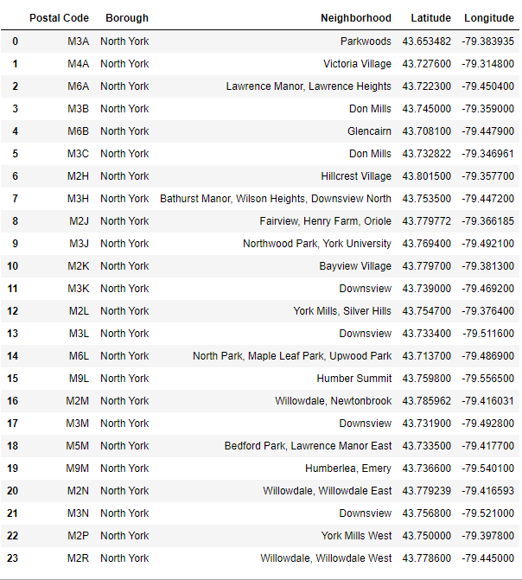
Data
This is the basic data which is required i.e.
Postal Code
Borough
Neighborhood
Latitude
Longitude

Slide 5
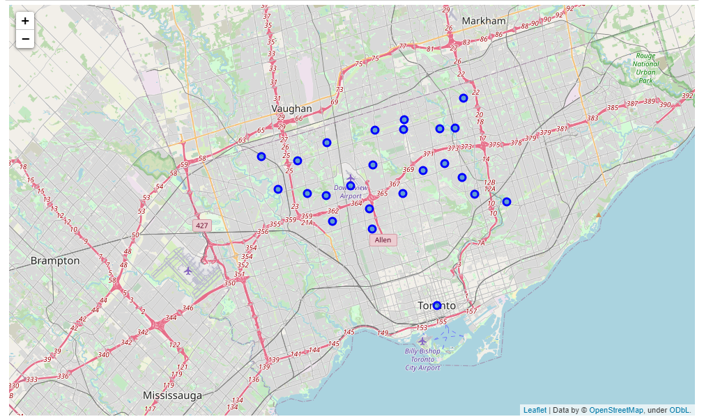
Data
This a map which plots the neighborhoods in North York borough

Slide 6
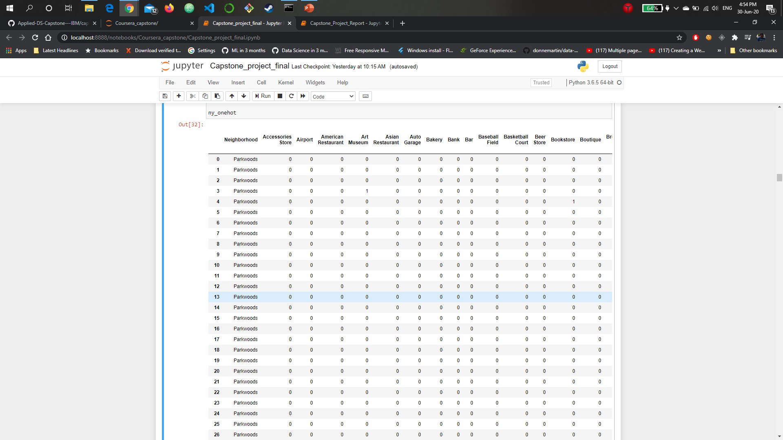
Data
This shows the one hot encoded data which is encoded along the venue Category

Slide 7
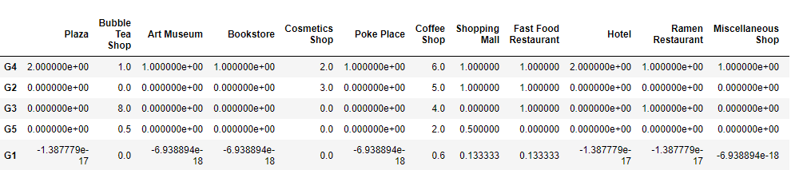
Clustering
We then use the encoded data with the list of important columns to train on the K means clustering algorithm
Which Produces 5 Clusters ranked most recommended to least based on the sum of no of venues present in the neighbourhood

Slide 8
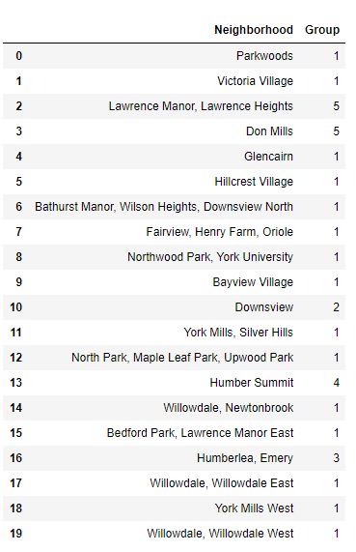
Clustering
This picture shows the clusters assigned to each neighborhood

Slide 9
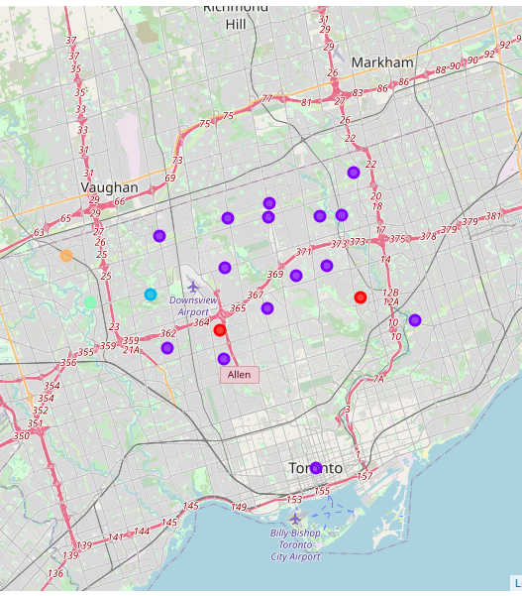
Plotting
This a map which plots the clustered neighborhoods in North York borough

Slide 10
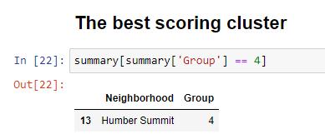
Results
The algorithm suggests the group 4 is the most suitable group to go with
Which contains the following neighborhood

Slide 11
Conclusion
Upon reviewing the above data we can devise two chains of thought
1. We go in the descending order i.e. the best cluster to be approached first so as to cover more shops
2. We go in the ascending order i.e. the least favorable cluster first so as to cover more area first
In the end we can conclude that the notebook provides enough data to help the salesman to devise a proper strategy for his coffee sales more ground and neighborhoods

Slide 12
Thank You
Feel free to make any suggestions on how I can improve this project
Happy Learning!

